Slide 1
MEIS System Overview
What are main MEIS functionalities and what benefits does the MEIS bring for LODA and Local Government?

Slide 2

LODA vision
“To effectively and efficiently contribute to sustainable development and poverty reduction through fund mobilization for decentralised entities”

Slide 3

History of MEIS
Tool to manage Local Development projects and Social Protection activities
2013
2015
2016
2017
2019
System development
First prototype available
Extended to project management tool and by SP workflows (DS, PW payrolls, payments, …
Upcoming ICT project to develop towards District enterprise resource system

Slide 4
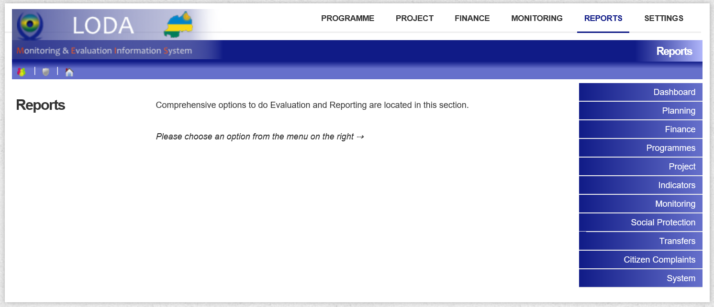
MEIS today

Slide 5








MEIS as a management and data tool
Needs & Profiling
Citizen priorities
Planning
Profiling
MEIS
PPDs and OPAFs
Budget
Data
Reports
Cabinet,
Technical Ministries,
Development Partner,
etc.
LED Projects
Works
Social Protection
Monitoring
SP workflows (DS, PW, FS)
IFMIS budget interface

Slide 6
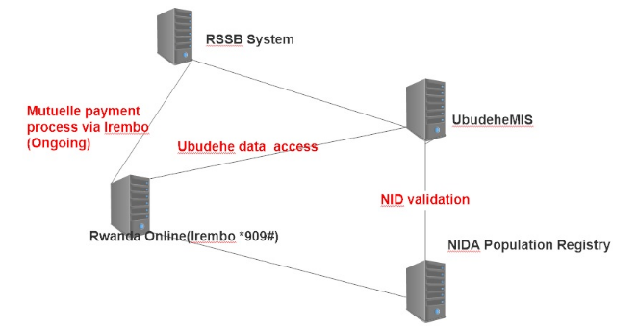
System Interconnections and interfaces
Notes:
Irembo has integrated with LODA MIS/Ubudehe Database. This will enable all updates made in the database to be accessible to citizens in real time
LODA has developed an interface with NIDA to retrieve and validate citizens information from NIDA database
Irembo has developed an interface for citizens to access Ubudehe database information via USSD/Web (*909#)
Once citizen retrieve their information from Ubudehe database can proceed making payment through Irembo platform

Slide 7
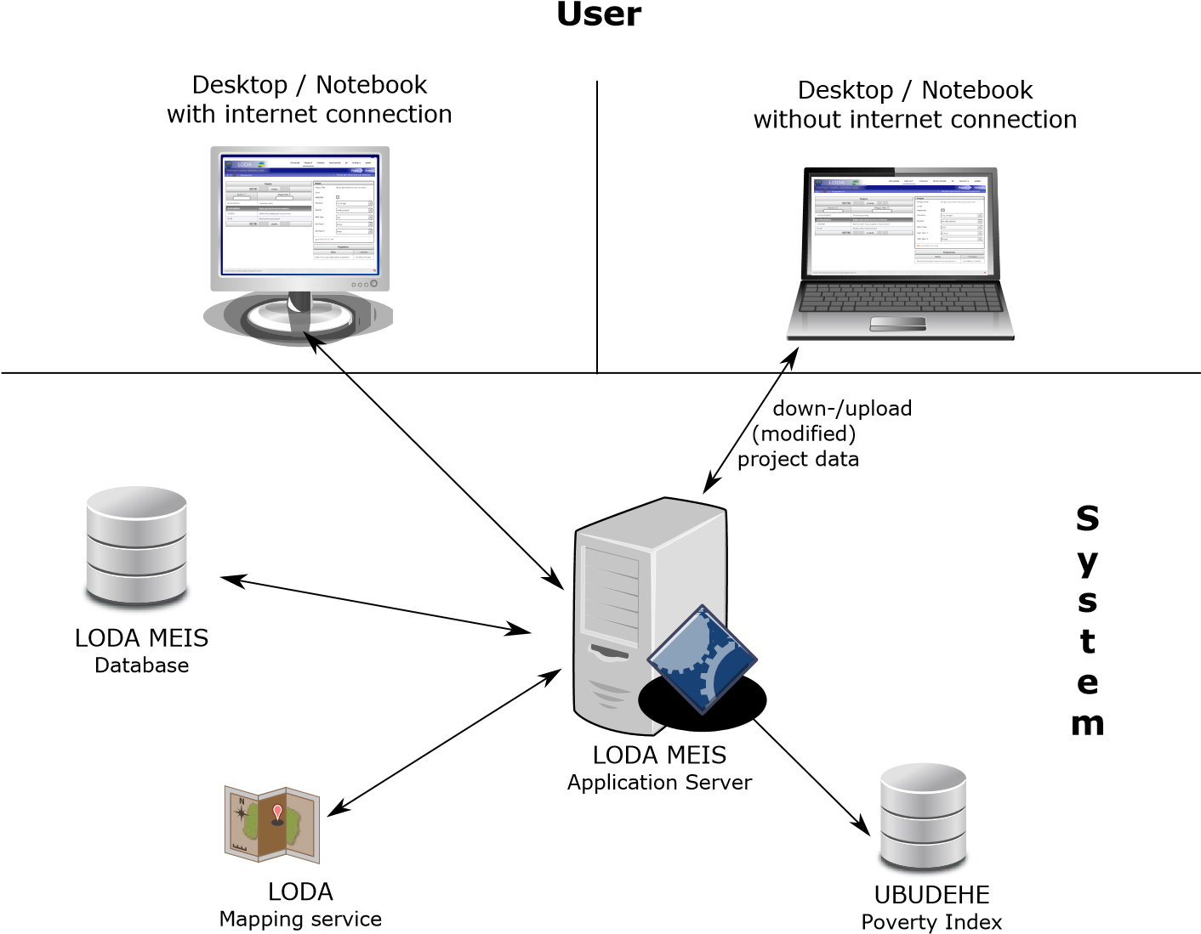

MEIS in numbers (2018)
Users | 2,088 active users registered
Trans-actions | 6.7 million transactions (data records changed) On average 63,000 transactions per day
Data | Data content: 5.5 gigabyte binary data Data base size: 2.7 gigabyte Relational data base system: 39 gigabyte 4,899 files uploaded

Slide 8
Murakoze cyane
Thank you very much

